Slide 1
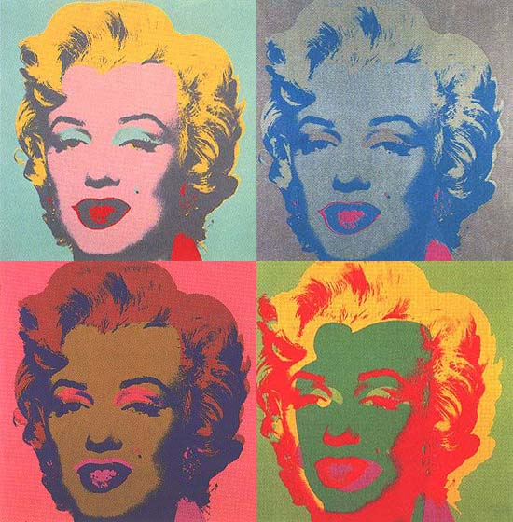
Research Design

Slide 2

Research Design PART 2
Qualitative Research Designs

Slide 3
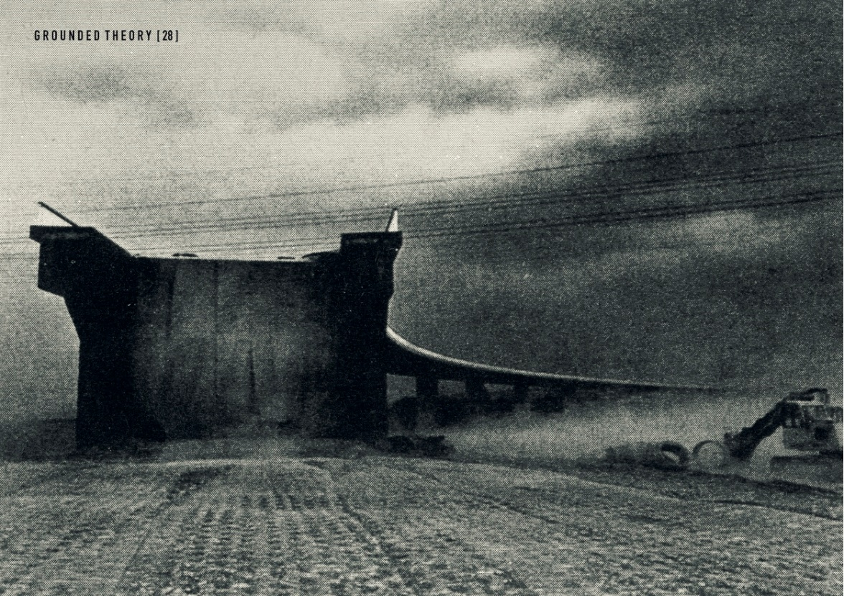
Research Design
Grounded Theory – Is a systematic, qualitative procedure used to generate a theory that explains, at a broad conceptual level, a process, an action, or an interaction about a substantive topic.

Slide 4

Research Design
Grounded Theory –
This theory is a process theory.

Slide 5
Research Design
Grounded theorists proceed through a systematic set of procedures; collecting data, identifying categories, connecting these categories and forming a theory that explains the process.

Slide 6
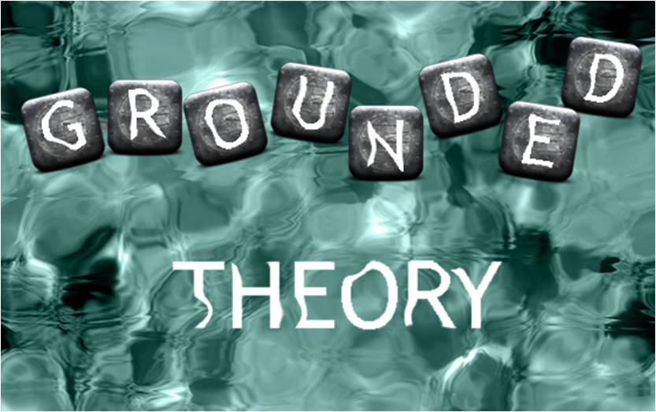
Research Design
You use grounded theory when you need a broad theory or explanation of a process. Grounded theory generates a theory when an existing theories do not address the problem.

Slide 7
Research Design
Types of Grounded Theory Designs –
Systematic Design emphasizing the use of data analysis step of open, axial, and selective coding and the development of a logic paradigm or visual picture of the theory generated.

Slide 8
Research Design
Grounded Theory –
Emerging Design – Glasser (1992) stressed that letting a theory emerge from the data rather than using specific, preset categories. The objective of grounded theory study was for the author to explain the basic social process. This explanation involved constant comparative coding procedures to comparing incident to incident, incident to category, and category.

Slide 9

Research Design
Grounded Theory – Constructivist Design –
Is more a philosophical position, and lies between the positivism (Qualitative) researchers and the post-modernist researchers who challenge the importance of methods.

Slide 10

Research Design
Grounded Theory – Constructivist Design –
The focus is on the meanings ascribed by participants in the study. More interested in the views, values, beliefs, feelings, assumptions, and ideologies of the individuals than facts and describing acts.

Slide 11

Research Design
Grounded Theory – Constructivist Design
Argue that any aspect that obscures experiences, such as complex terms or jargon, diagrams, or conceptual maps, detract from grounded theory and represent an attempt to gain power in their use.

Slide 12

Research Design
Grounded Theory – Constructivist Design – Emphasise the role of the researcher they make decisions about the categories through out the study. They bring certain questions to the data along with a store of sociological concepts, and their own world view.

Slide 13
Research Design
A grounded theorist explains the feelings of individuals as they experience the process.
“What it means to have the disease.” (Charmaz, 1994)

Slide 14
Research Design
Constuctivist
In both cases, the theory of constructivism suggests that learners construct knowledge out of their experiences. However, constructivism is often associated with pedagogic approaches that promote active learning, or learning by doing.

Slide 15
Research Design
The term postmodernism has been applied to a host of movements, mainly in art, music, and literature, that reacted against tendencies in modernism, and are typically marked by revival of historical elements and techniques.
Postmodernism is renowned for its extravagant aestheticism, irregular beauty and unashamed devotion to style over substance.

Slide 16
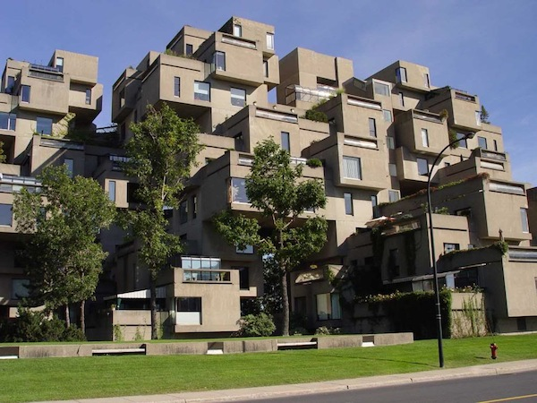

Research Design

Slide 17
Research Design
Grounded Theory – Key Characteristics
1. Process approach
2. Theoretical sampling
3. Constant comparative data analysis
4. A core category
5. Theory generation
6. Memos

Slide 18
Research Design
Grounded Theory – Ethical issues
The writing on grounded theory are largely silent on ethical issues in the conduct of research. This does not mean that grounded theory is unethical.

Slide 19
Research Design
Grounded Theory – Ethical issues
Ethical issues face grounded theory researchers when they declare the purpose of the study knowing that it will emerge through the grounding in the participants views. It does raise the question of power and authority and giving appropriate voice to participants about the research process

Slide 20
Research Design

